Slide 1

PURWADHIKA DTI DS
Predicting Used Car Price
Creating a machine learning model to predict price of used car by using the dataset from website syarah.com

Slide 2


CONTENT
1
BUSINESS PROBLEM
4
CONCLUSION
2
DATA UNDERSTANDING & PREPARATIONS
5
RECOMMENDATION
3
CREATE MODEL
6
DEMO MODEL (GCP)

Slide 3

Context
The used car market in Saudi Arabia is growing rapidly, with a diverse range of cars available across different regions.
Business Problem
Sellers often struggle to determine the price market, especially within the specific price range of the market (under 300k) with the variability of car conditions, features, market demands etc.

Slide 4

Goals
Predict the price of non-negotible used cars within range under SAR300k
Finding features that are affecting the most.
Why using price range under 300k?
After observation from the dataset and internet research, this price range is a sweet spot to get an affordable used car, for example, if a buyer looking for an old luxury type of car.

Slide 5




Why we need Machine Learing?
Optimize the pricing startegy
Boost customer trust
Help set a competitive price to prevent overpriced and underpriced of used car.
By setting fair prices, car sellers win customer trust and loyalty.

Slide 6
List of the data
Type: Type of used car.
Region: The region in which the used car was offered for sale.
Make: The company name.
Gear_Type: Gear type size of used car.
Origin: Origin of used car.
Options: Options of used car.
Year: Manufacturing year.
Engine_Size: The engine size of used car.
Mileage: Mileage of used car.
Negotiable: True if the price is 0, it means negotiable.
Price: Used car price.

Slide 7

Data Understandings
Target: Price
Features: Type, 'Region, Make, Gear_Type, Origin, Options, Year, Engine_Size, and Mileage.
The dataset consists of 5624 data
There are a total of 705 outliers in numerical data
Toyota has become the most profitable brand for used cars priced under 300k

Slide 8
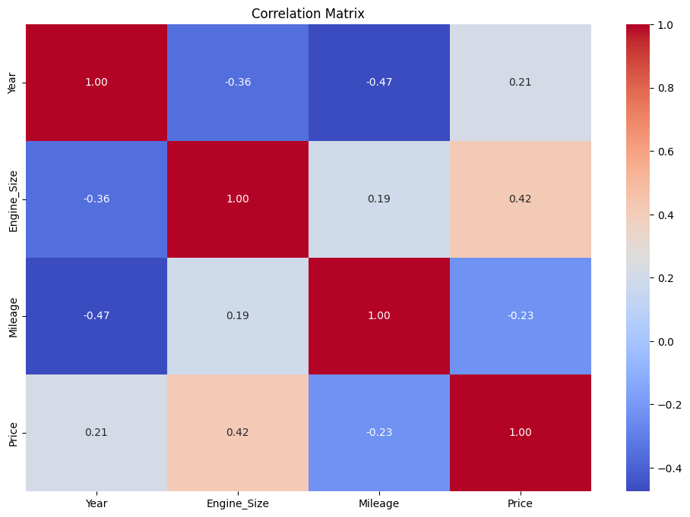
Relation between numerical features and price
Strong correlation:
Engine size and Price (0.42)
Weak correlation:
Mileage and Price (-0.23)

Slide 9

Data Cleaning & Preparations
Delete the duplicated data: 4
Drop the column Negotiable
Drop the ‘Unknown’ values inside the column Origin
Create a threshold for each numerical column:
Year ( range between 2011-2021)
Price ( SAR26,000 - SAR298,000)
Mileage (100 - 277,000)
Engine size ( 1.0 - 6.3)

Slide 10
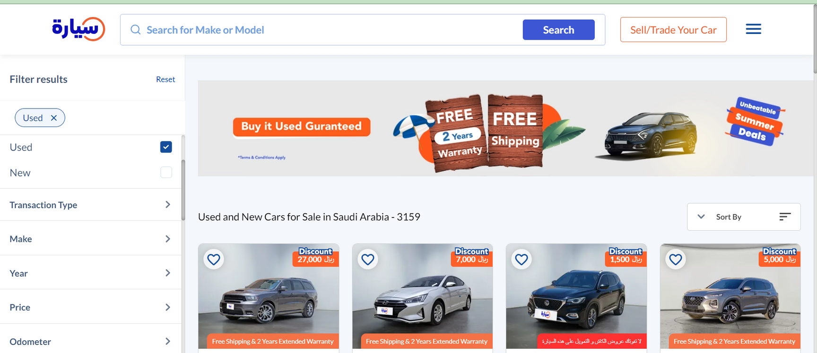
Website of Syarah
Mainly the threshold is come from the website filter.

Slide 11


Create a Regression Model
A regression model is suitable for predicting used car prices because it can handle multiple predictors, non-linear relationships, and continuous output values, making it a robust and accurate approach for estimating the price of a used car.

Slide 12
Process of Creating Model
Split the data
Feature engineering & preprocessing
Choosing the machine learning model
Tuning the models
Evaluate the models

Slide 13



Split the data
Feature Engineering
Scaler
Encoding
Apply preprocessing
Crossvalidation
Bencmark the models
Train the models
To be continued after the next slide

Slide 14
Choosing the Model
Why XGBoost Regression?
XGBoost, short for Extreme Gradient Boosting, is a super-effective tool used to learn from data. It is known for its ability to handle large datasets, high-dimensional data, and complex relationships between features.

Slide 15
Let’s continue...
XGBoostRegression
Tuning the model
Parameters
Random Search
Save the model
Evaluate the model
Metrics evaluations(RMSE,MAE,MAPE, Adjusted R2)

Slide 16
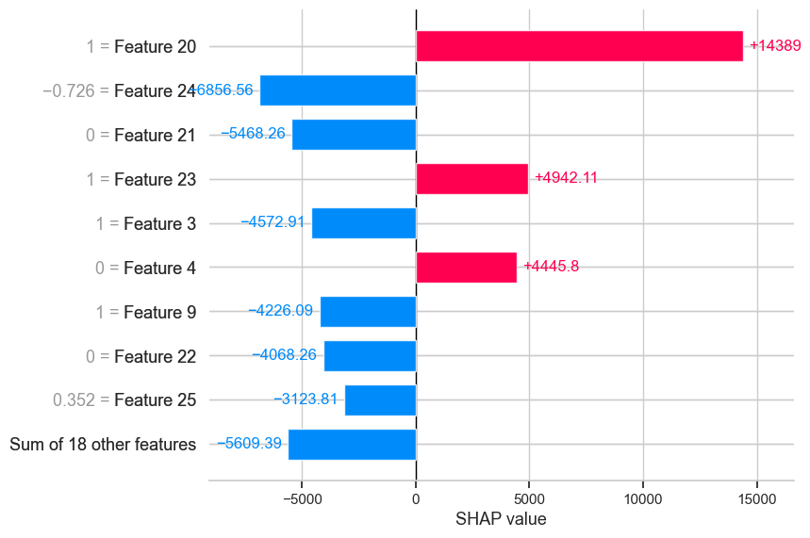
Model interpretation
Descriptions
Feature 20: Brand_2
Feature 24: Year
Feature 21: Brand_3
Feature 23: Brand_ 5
Feature 3: Options Semi Full
Feature 4:Options Standard
Feature 9: Type_4
Feature 22: Brand_4
Feature 25: Engine size

Slide 17

Conclusion
The chosen machine learning model can predict prices with a range of accuracy differences between 1.87% - 4.7% with the actual prices.
Brand and Option Standard are the most influential factors in determining the increase in car prices.
Year and Engine size are the most influential factors in determining the decrease of car prices.

Slide 18

Model limitation
This model is currently limited to predicting prices for used cars under SAR 300,000. As a result, accuracy may decrease for cars outside this price range
Model Recommendation
Add features like accident history and explore connections between existing ones (engine size and mileage) to uncover hidden patterns and refine predictions.
Expanding the price range above 300k with additional features can unlock new, potentially valuable insights for the future.

Slide 19

Let’s try to do predict in Google Cloud

